Slide 1
Predicting Cesarian Related Surgical Wound Infection in Rwandan Patients
Subby Olubeko
Harsh Sonthalia
Joanna Ashby
Notes:
SVM description
Visualization for image model
LAB visualization vs. RGB
Demo running model
Updates slide (Future work)

Slide 2
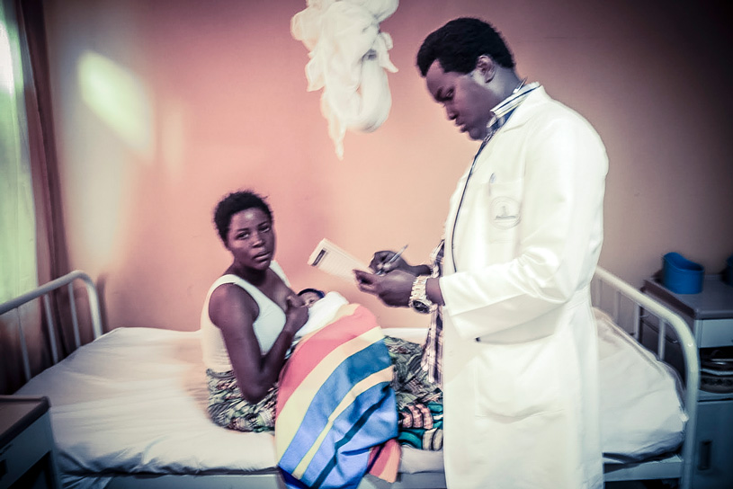
Overview
> 50% of surgeries in rural east Africa are C-sections
10-15% of patients develop surgical site infections (SSIs)
Leading cause of female mortality in Rwanda

Slide 3
AI Referral Tool
Promising solution for medical image interpretation and triage
Generalise - to new populations and devices
Applicable - to real-world scans, problems pathways
match/ exceed performance of human experts
Recent breakthroughs demonstrating expert-level performance on 2D images in pre-clinical settings; not promise yet shown clinical applicability by resolving all three
Notes:
To to new populations and devices without loss of performance

Slide 4
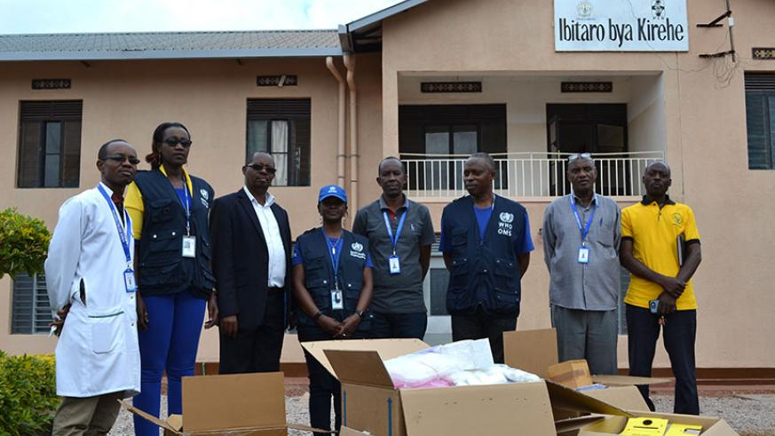
Goal
Model to assist Rwandan health workers in identifying SSIs and referring women to care.
Based on randomized controlled trial conducted at Kirehe District Hospital (KDH) in Rwanda

Slide 5
Prior Work

Slide 6
Harvard Study
Conducted on KDH patients 18+ years old who had C-sections in the last year
Randomly split between 3 groups. ~10 days after operation patients experienced:
Group 1: Visited at home by health worker who administered SSI screening protocol on tablet.
Group 2: Screened over phone by health worker.
Group 3: No follow-up

Slide 7
Harvard Study
Patients in groups 1 and 2 that responded ‘yes’ to any screening questions were referred to health facility.
10 question questionnaire administered independently by GP and CHW.
Images were collected from all patients

Slide 8
Screening Questions
Has the patient experienced fevers since the surgery?
Has the patient experienced pain around the incision?
Is there redness around the incision?
Is there swelling around the incision?
Is there firmness around the incision?
Is there drainage?
Is the drainage thick or thin?
What color is the drainage?
Does the drainage have a smell?
Is the wound gaping?

Slide 9
Community Health Worker
Best subset of questions:
Fever
Pain
Discolored drainage
Sensitivity: 76.2%
Specificity: 81.4%

Slide 10
General Physician
Best subset of questions:
Fever
Gaping wound
Discolored drainage
Sensitivity: 95.2%
Specificity: 83.3%

Slide 11
MIT Work

Slide 12
Data
Patient questionnaire + Images

Slide 13
Evaluation
100 Trials
Random splits (75% train, 25% test)
Stored medians and ranges

Slide 14
Questionnaire Models
572 patients (61 infected)
13 question responses (features)
Models
Logistic regression (L1 penalty)
Logistic Regression (L2 penalty)
SVM

Slide 15
L1 Questionnaire Model Results
Accuracy: 95.80% (92.31% - 100%)
Sensitivity: 0.7134 (0.4545 - 1.0)
Specificity: 0.9846 (0.9627 - 1.0)
Notes:
L1 loss uses the least deviation from the given data

Slide 16
L1 Questionnaire Model Confusion Matrix
 |  | Predicted Class
 |  | Not Infected | Infected
Actual Class | Not Infected | 126 (117 - 133) | 2 (0 - 5)
 | Infected | 5 (0 - 9) | 11 (5 - 17)

Slide 17
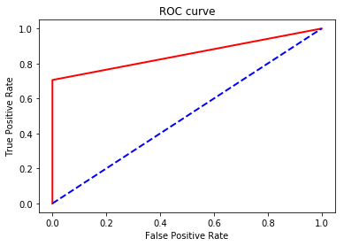
L1 Questionnaire Model ROC
ROC Curve:
AUC: 0.8529 (0.7235 - 1.0)

Slide 18
L1 Questionnaire Model Feature Relevances
Feature | Coefficient Value
Draining with smell | 3.61 (2.78 — 4.46)
Draining color (Brown, Yellow, Green, White) | 2.23 (1.05 — 3.32)
Fever | 0.97 (0 — 1.73)
Pain | 0.95 (0 — 1.84)
Thick draining | 0.95 (0 — 2.29)
Draining | 0.50 (0 — 1.43)
Firmness | 0.49 (0 — 1.34)
Gape | 0.12 ( 0 — 1.34)
Redness | 0.09 (0 — 1.86)
Notes:
Swelling, Thin Draining, Draining without Smell,

Slide 19
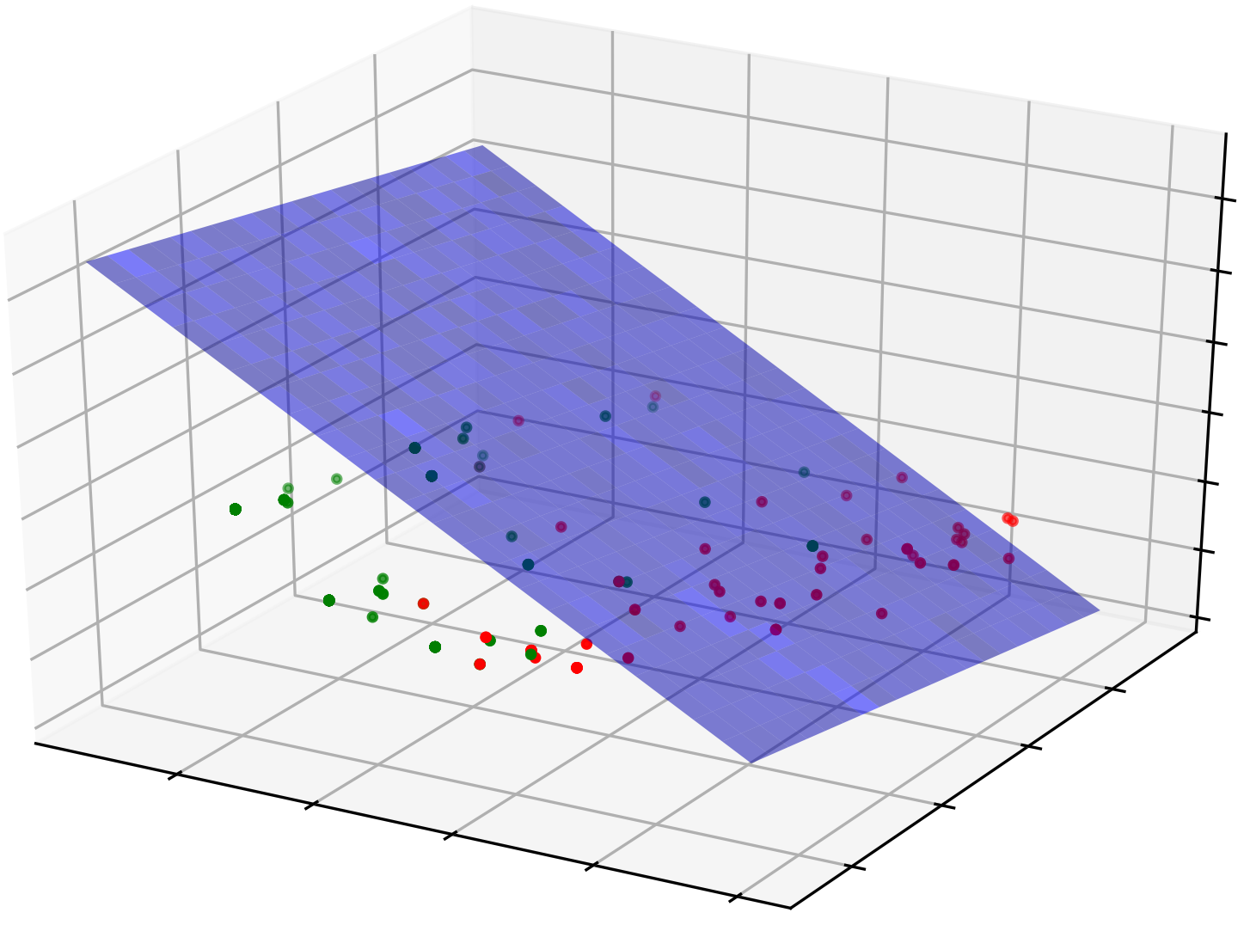
Data Visualization
Legend
Uninfected Patients
Infected Patients
Classifier Boundary
Notes:
Get rid of numbers
Do for all models

Slide 20
L2 Questionnaire Model Results
Accuracy: 96.50% (91.61% - 99.30%)
Sensitivity: 0.75 (0.4118 - 0.9333)
Specificity: 0.9921 (0.9615 - 1.0)

Slide 21
L2 Questionnaire Model Confusion Matrix
 |  | Predicted Class
 |  | Not Infected | Infected
Actual Class | Not Infected | 126 (119 - 133) | 1 (0 - 5)
 | Infected | 4 (1 - 11) | 11 (5 - 18)

Slide 22
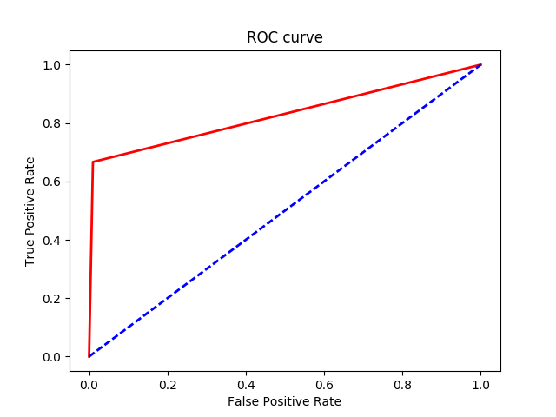
L2 Questionnaire Model ROC
ROC Curve
AUC: 0.8666 (0.7058 - 0.9666)

Slide 23
L2 Questionnaire Model Feature Relevances
Feature | Coefficient Value
Draining with smell | 2.01 (1.76 — 2.31)
Draining color (Brown, Yellow, Green, White) | 1.62 (1.32 — 2.03)
Draining | 1.29 (1.07 — 1.53)
Thick Draining | 1.15 (0.69 — 1.52)
Draining without smell | -0.83 (-1.22 — -0.61)
Fever | 0.81 (0.01 — 1.29)
Pain | 0.76 (0.10 — 1.16)
Feature | Coefficient Value
Redness | 0.56( -0.51 — 1.24)
Swelling | 0.51 (-0.30 — 1.21)
Gape | 0.50 (-0.07 — 1.11)
Firmness | 0.44 (-0.47 — 0.98)
Draining color (Red, Pink, Clear) | -0.33 (-0.96 — 0.02)
Thin draining | 0.11 (-0.22 — 0.56)

Slide 24
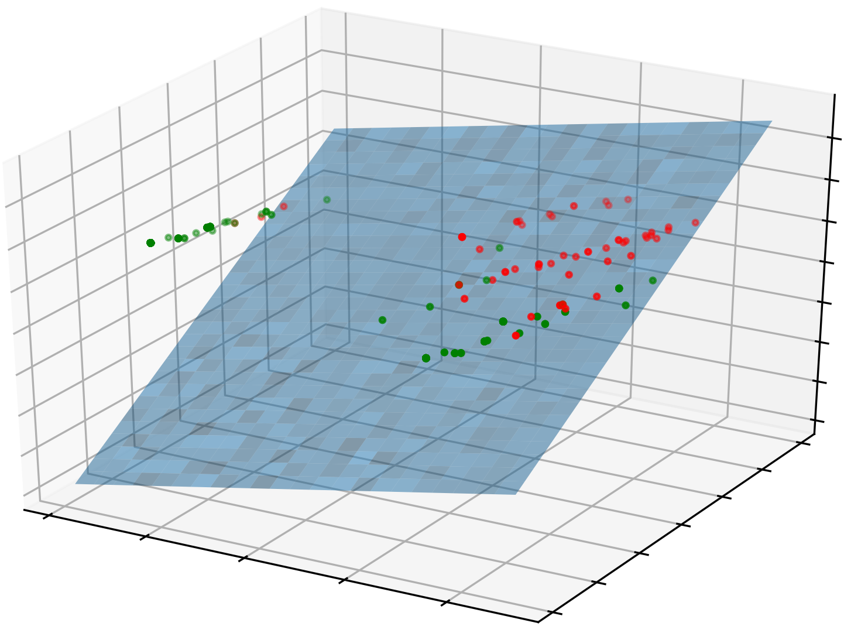
Data Visualization
Legend
Uninfected Patients
Infected Patients
Classifier Boundary
Notes:
Get rid of numbers
Do for all models

Slide 25
SVM Questionnaire Model Results
Accuracy: 96.50% (93.01% - 99.30%)
Sensitivity: 0.7059 (0.3333 - 0.9286)
Specificity: 1.0 (0.9841 - 1.0)

Slide 26
SVM Questionnaire Model Confusion Matrix
 |  | Predicted Class
 |  | Not Infected | Infected
Actual Class | Not Infected | 127 (120 - 134) | 0 (0 - 2)
 | Infected | 4 (1 - 9) | 10 (4 - 20)

Slide 27

SVM Questionnaire Model ROC
ROC Curve
AUC: 0.8490 (0.6667 - 0.9643)

Slide 28
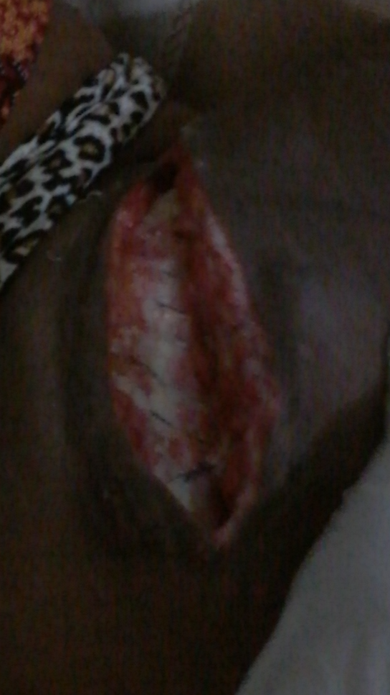
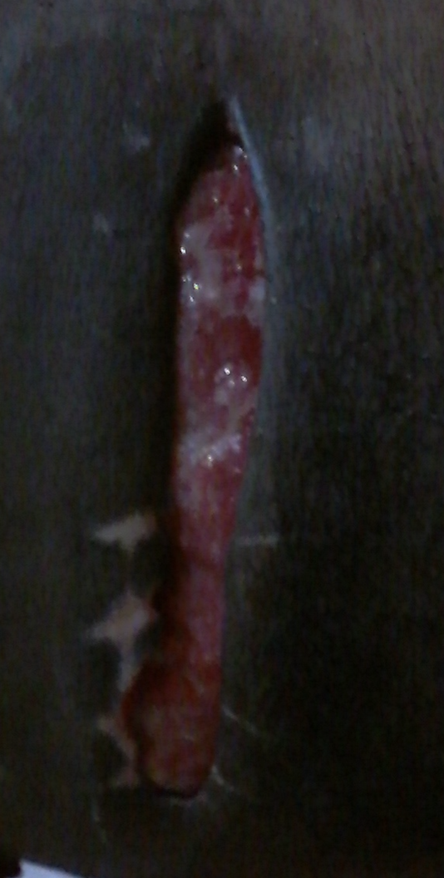
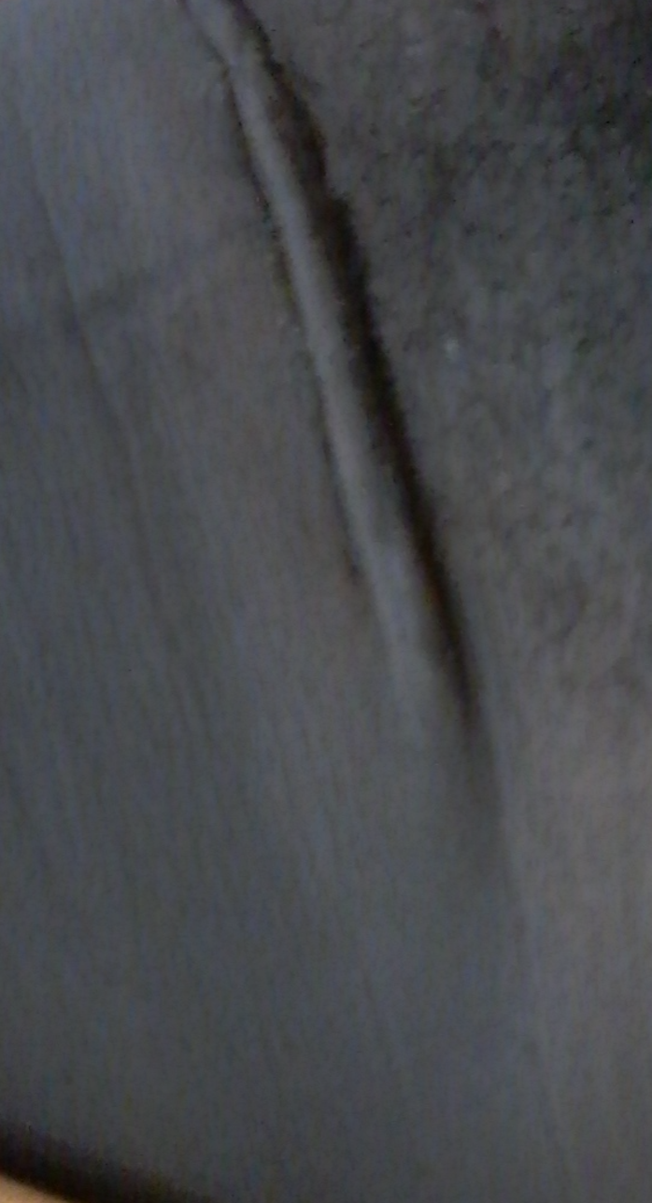
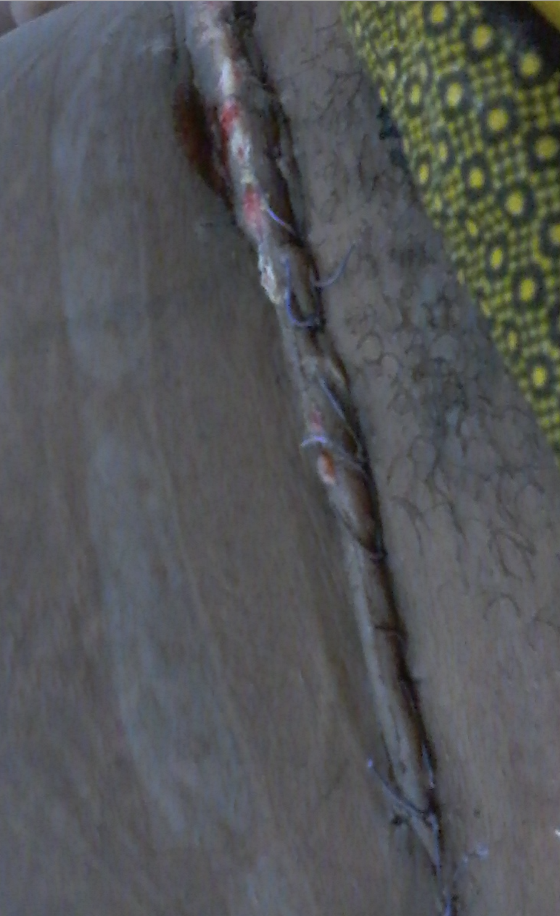
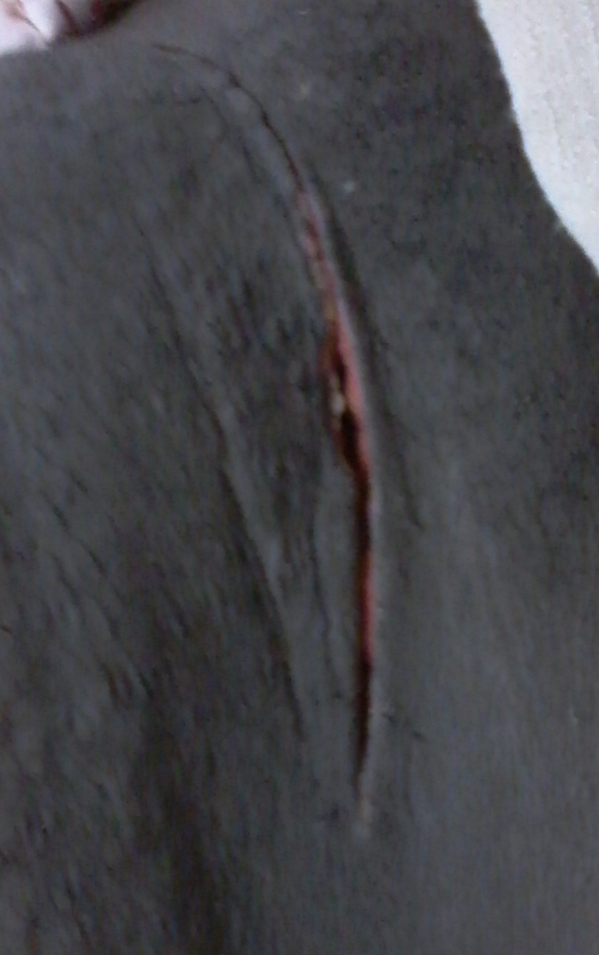
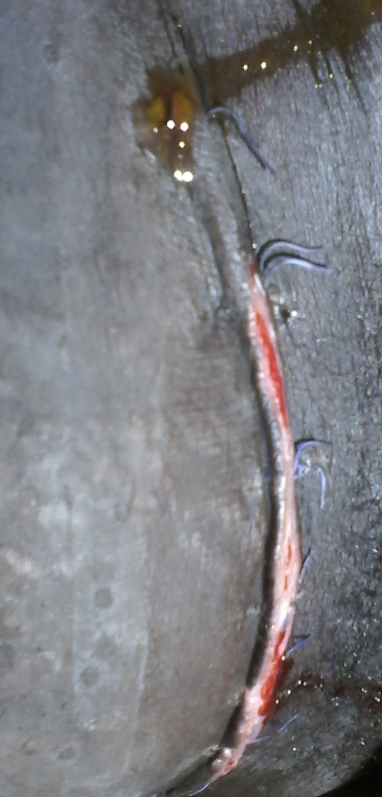
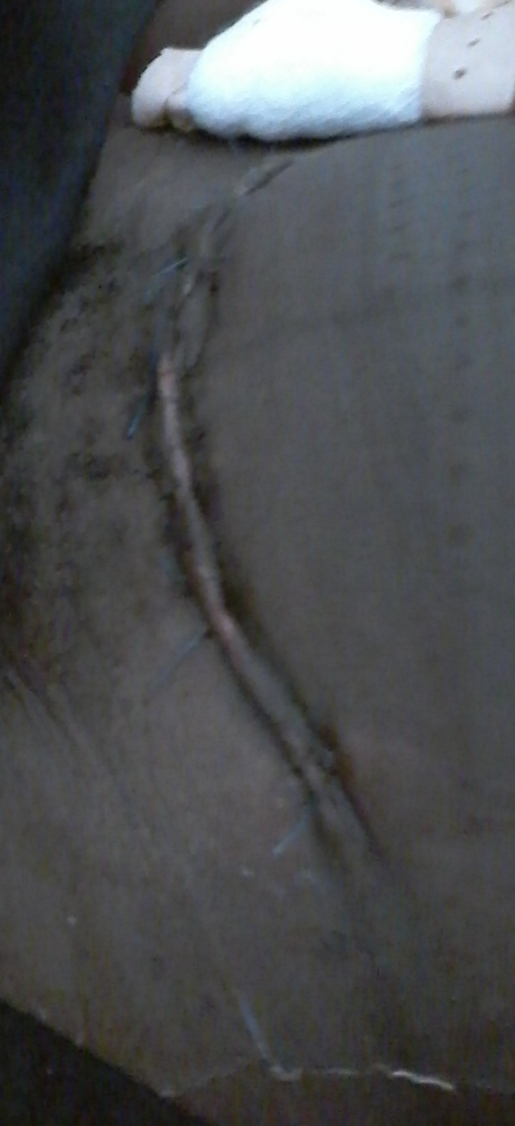
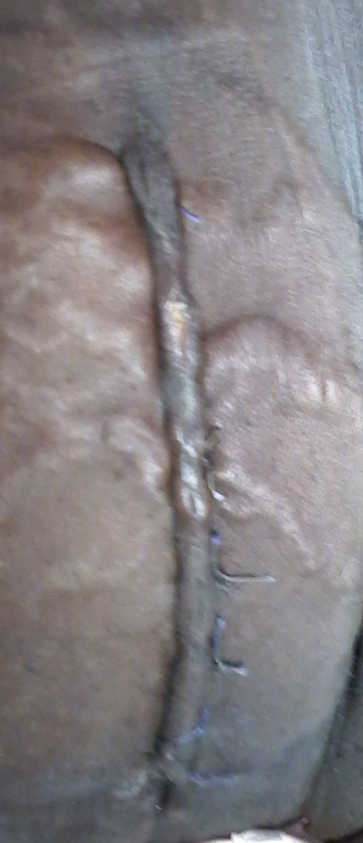
Images
Infected Not Infected

Slide 29


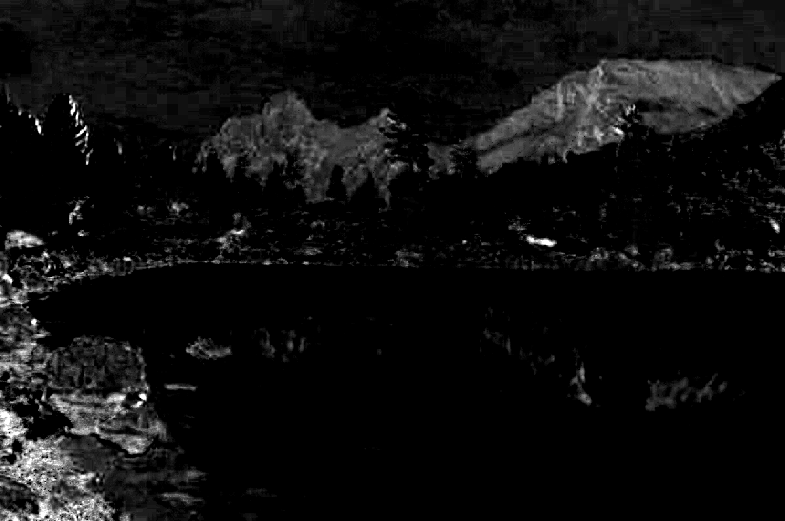
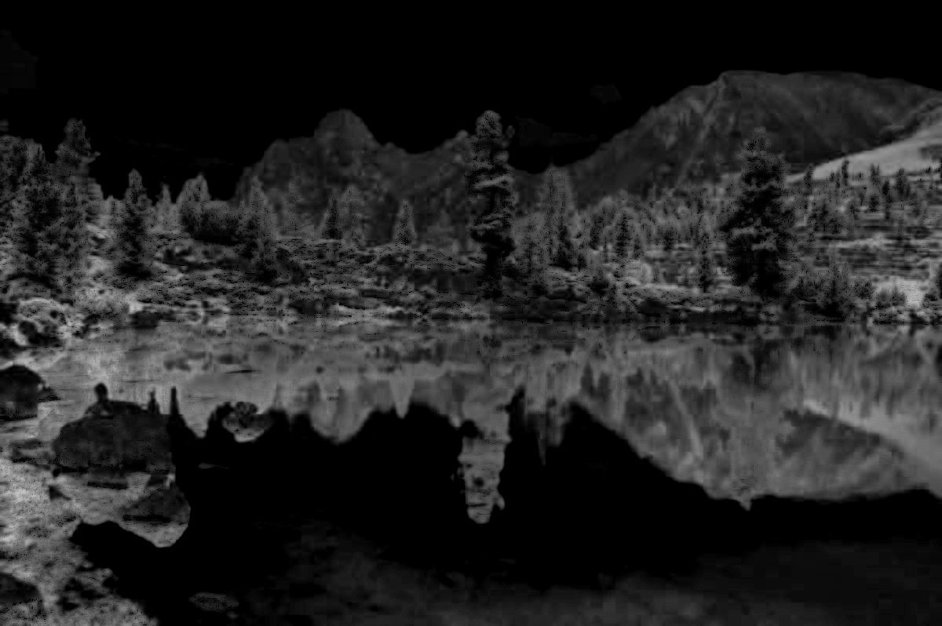
LAB Visualization
RGB Image:
L Component A Component B Component

Slide 30
Image Model
568 patients (62 infected)
Transformations
Scale (160x340)
RGB to LAB
Features:
Local Gabor Binary Pattern Histograms
Color Histograms
Mean, Variance, and Skewness
7784 total features per image!
Logistic regression with L1 penalty

Slide 31
Image Model Results
Accuracy: 100% (99.296% - 100%)
Sensitivity: 1.0
Specificity: 1.0 (0.9922 - 1)

Slide 32
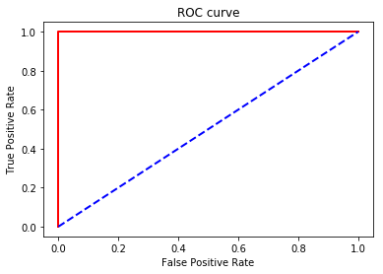
Image Model ROC
ROC Curve
AUC: 1.0 (0.9961 - 1)

Slide 33
Image Model Feature Results
Number of selected features: 25 (19 - 29)
Most important features:
L component block means
A component block means
B component block means

Slide 34
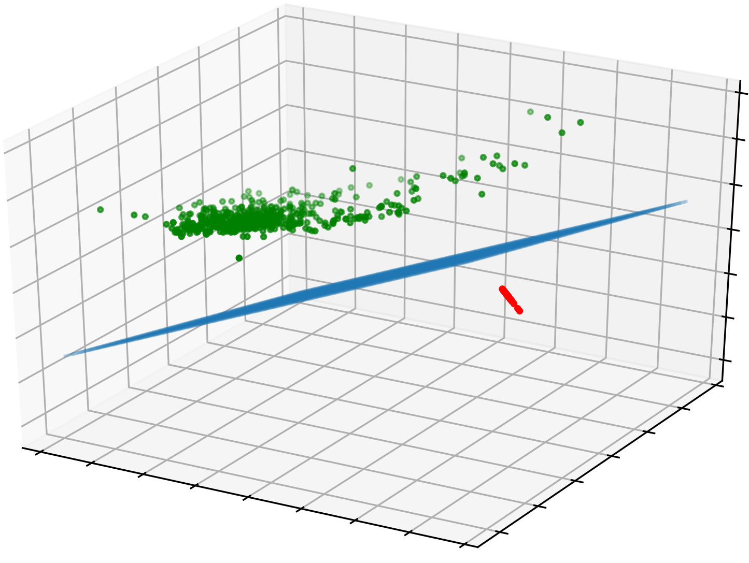
Data Visualization
Legend
Uninfected Patients
Infected Patients
Classifier Boundary
Notes:
Get rid of numbers
Do for all models

Slide 35
Combined Model
552 patients
7797 features per patient
Logistic regression with L1

Slide 36
Combined Model Results
Accuracy: 100%
Sensitivity: 1.0
Specificity: 1.0

Slide 37
Combined Model ROC
ROC Curve
AUC: 1.0

Slide 38
Combined Model Feature Results
Number of selected features: 28 (22 - 31)
Most important features:
L component block means
Draining with Smell
Draining color (Brown, Yellow, Green, White)
A component block means
B component block means

Slide 39
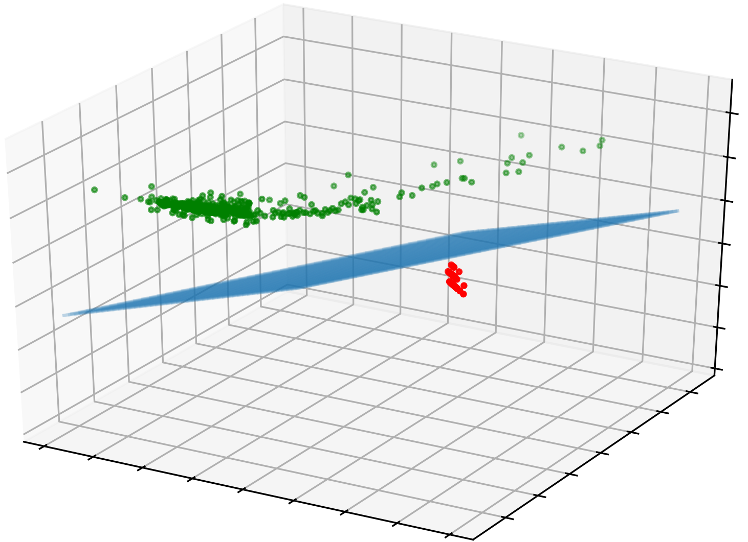
Data Visualization
Legend
Uninfected Patients
Infected Patients
Classifier Boundary
Notes:
Get rid of numbers
Do for all models

Slide 40
Summary

Slide 41
Results Summary
Model | Accuracy | Sensitivity | Specificity | ROC AUC | Features used
GP Questionnaire | — | 0.952 | 0.833 | 0.8925 | 3
Questionnaire with L1 | 95.80% (92.31% - 100%) | 0.7134 (0.4545 - 1.0) | 0.9846 (0.9627 - 1.0) | 0.8529 (0.7235 - 1.0) | 9
Questionnaire with L2 | 96.50% (91.61% - 99.30%) | 0.75 (0.4118 - 0.9333) | 0.9921 (0.9615 - 1.0) | 0.8666 (0.7058 - 0.9666) | 13
Questionnaire with SVM | 96.50% (93.01% - 99.30%) | 0.7059 (0.3333 - 0.9286) | 1.0 (0.9841 - 1.0) | 0.8490 (0.6667 - 0.9643) | 13
Images | 100% (99.30% - 100%) | 1.0 | 1.0 (0.9922 - 1.0) | 1.0 (0.9961 - 1.0) | 25 (19 - 29)
Questionnaire + Images | 100% | 1.0 | 1.0 | 1.0 | 28 (22 - 31)

Slide 42
Conclusion
Image data for SSI prediction is likely the best way forward.
Using images instead of questionnaire results bypasses the issue of patients inaccurately reporting answers.

Slide 43
Future Work
Realtime field prospective validation.
Infrared Images to support development of new algorithms
CHW- user friendly tool.

